Slide 1
Business Process Engineering
Week 4

Slide 2
Business Canvas Model
Every business idea does need a plan.
Modern entrepreneurs are equipped with more efficient methods and tools that make planning easier.
canvas model may serve as a visual representation of your business plan.

Slide 3
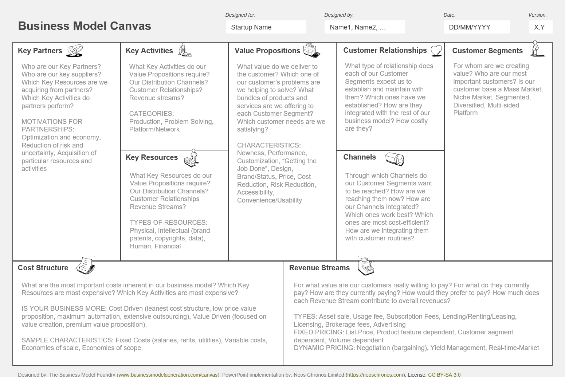

Slide 4
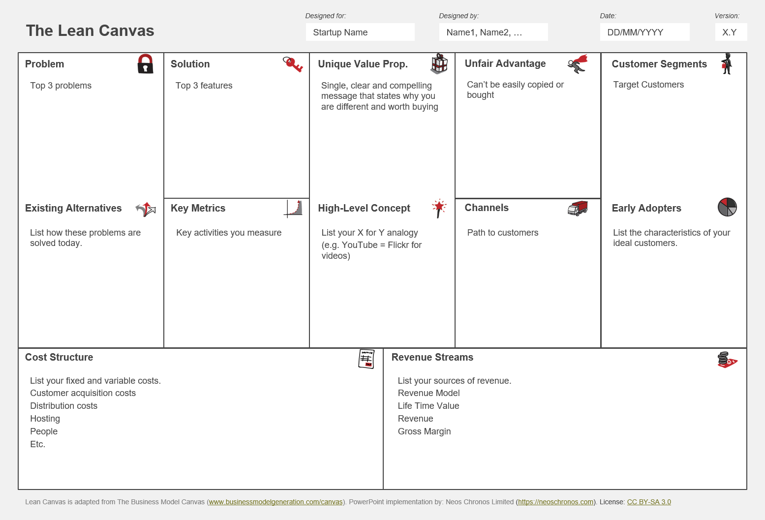

Slide 5
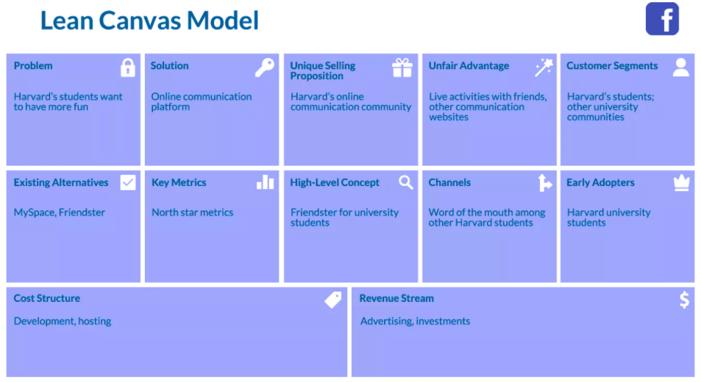

Slide 6
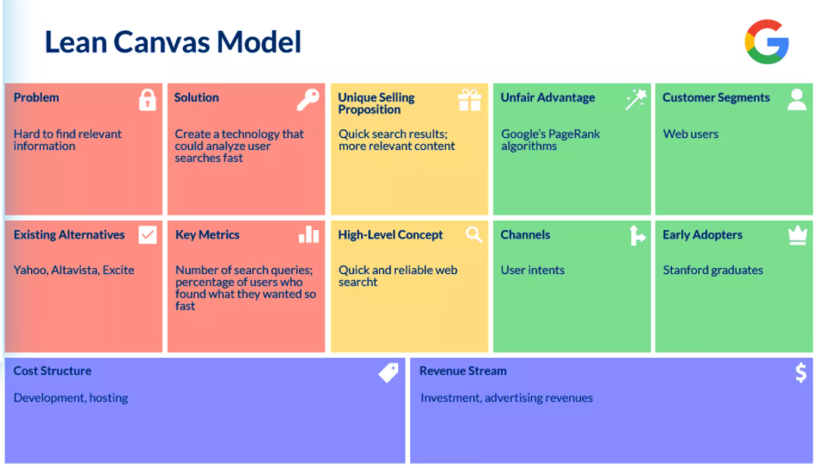

Slide 7
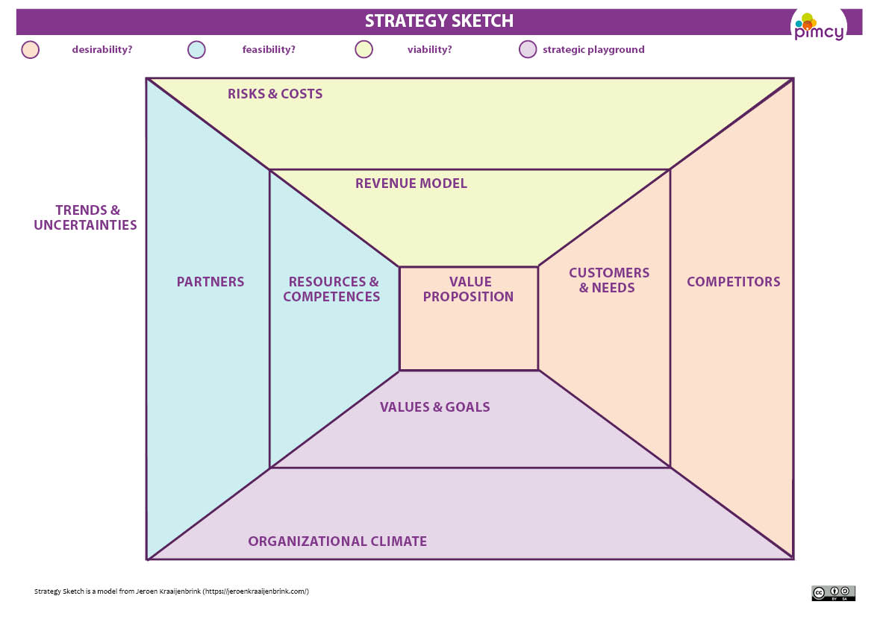

Slide 8
Case company is an international technology business. The company is founded March 2017 by Hong Kong based stock listed company with one Finnish investor. The business idea of the company is to develop camera modules for the different markets. At this moment they are producing three different camera modules. In the value proposition part, I focus only on developing the value proposition for their artificial intelligence camera. Two other products are excluded. Case company's artificial intelligence camera has working name dangerous detector because its AI features can analyze video feed and make assumptions if some people are potentially dangerous and worth of investigating more. For this product, their primary customer segments are customs and law enforcement. Case company has six full-time employees at present, four in Oulu office, one in Moscow and CEO is in Hong Kong. Growth has been rapid because since in the start of the year 2018 the company only had two employees

Slide 9
